Slide 1


Supervised Learning: Classification
Supervised learning is a powerful machine learning technique where an algorithm is trained on labeled data to make predictions or classify new, unknown data. Classification is a key supervised learning task that assigns data to specific categories or classes.
Notes:
1

Slide 2

What is Supervised Learning?
1
Labeled Data
2
Predictive Modeling
Supervised learning requires a dataset with known, labeled examples to train the algorithm.
The algorithm learns patterns in the data to make predictions or classifications on new, unseen data.
3
Continuous Feedback
The model's performance is evaluated, and the algorithm is iteratively improved based on the results.
Notes:
2

Slide 3

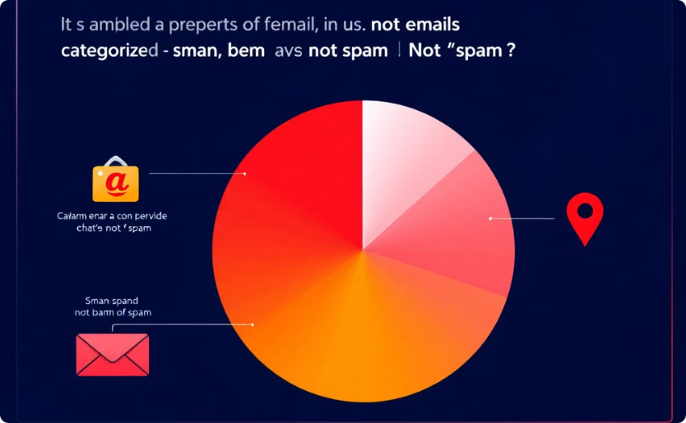
Regression vs. Classification
Regression
Classification
Predicts a continuous, numerical output value.
Assigns data to discrete categories or classes.
Example: Predicting a house's sale price.
Example: Classifying emails as "spam" or "not spam".
Notes:
3

Slide 4

Common Classification Algorithms
Logistic Regression
Decision Trees
Predicts the probability of a binary outcome.
Recursive partitioning of data based on feature values.
Support Vector Machines
Neural Networks
Finds the optimal hyperplane to separate classes.
Complex, interconnected models inspired by the brain.
Notes:
4

Slide 5
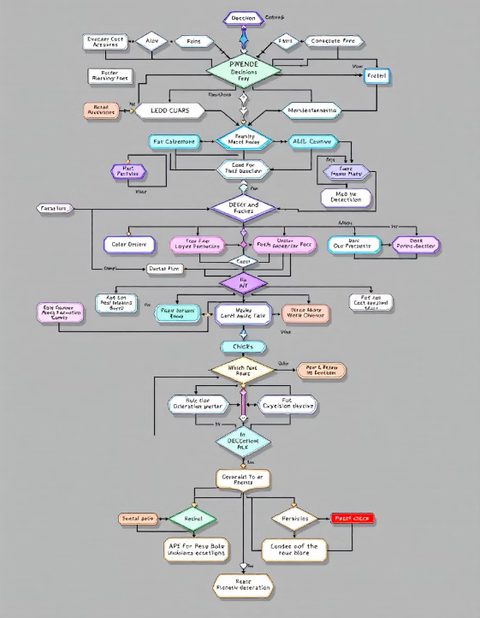
Decision Tree
Decision Making
Decision trees are a powerful supervised learning algorithm that recursively partitions data based on feature values. They create a tree-like model of decisions and their possible consequences.
Notes:
9

Slide 6
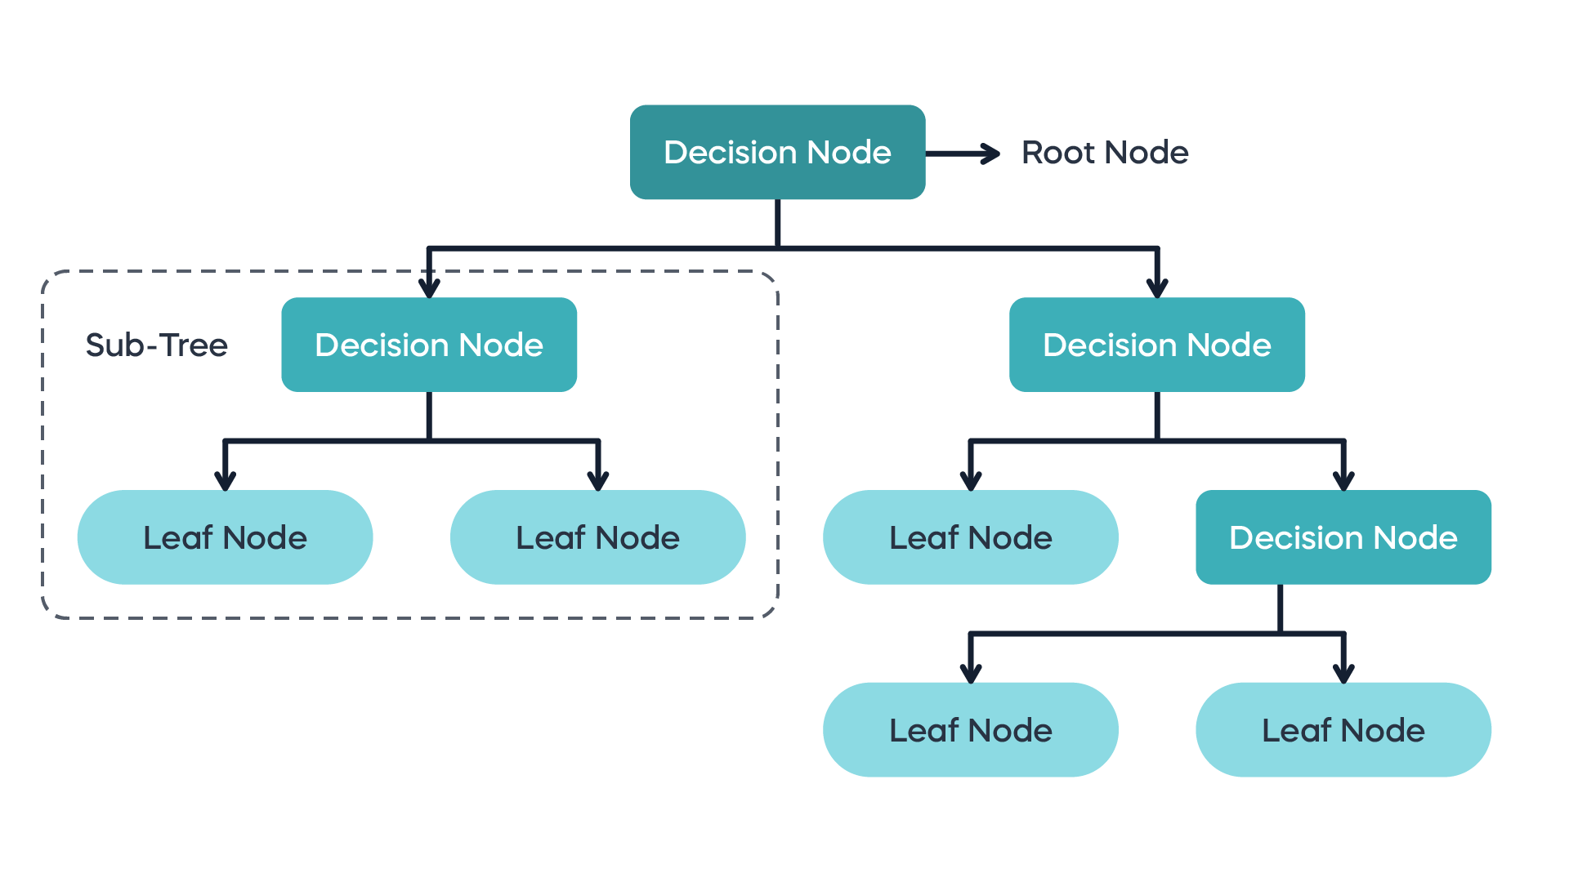

Slide 7
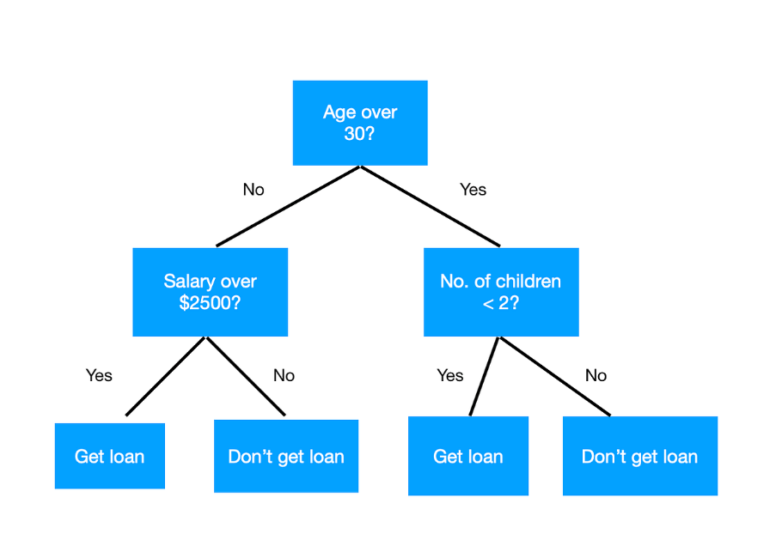

Slide 8
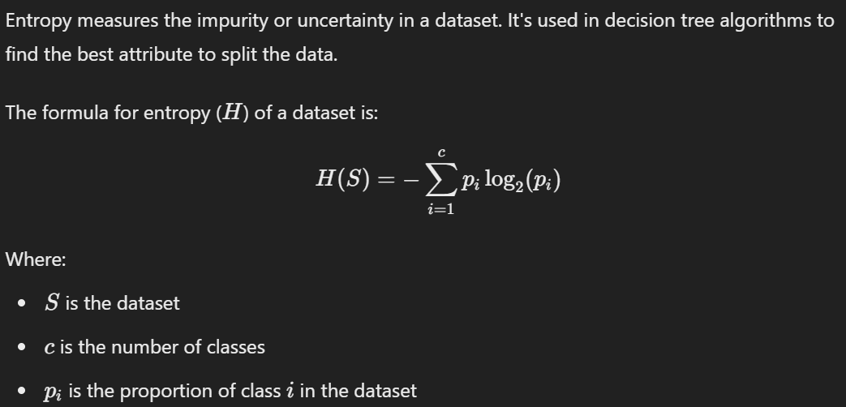

Slide 9
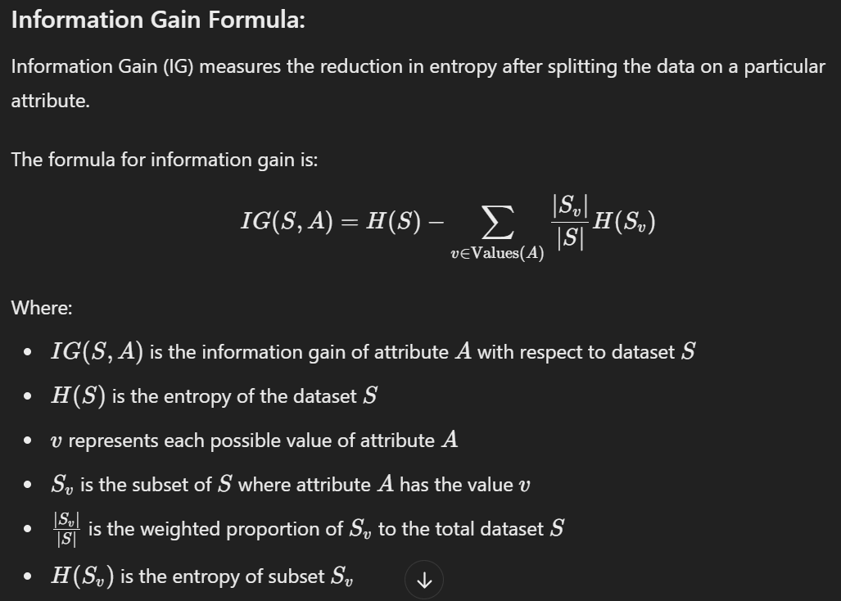

Slide 10
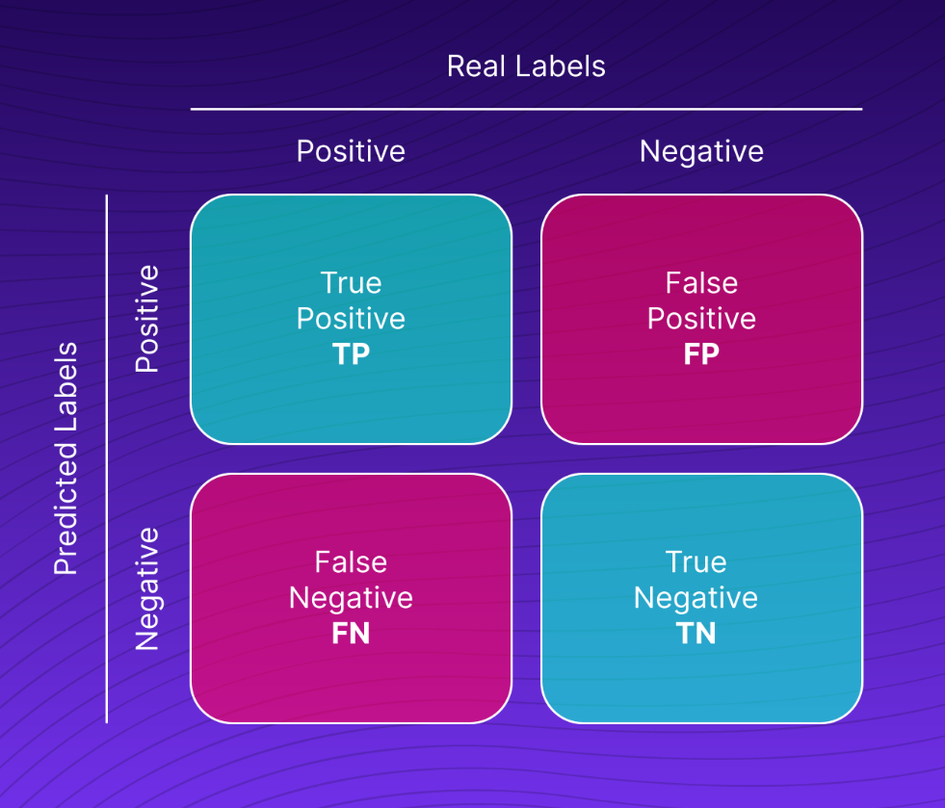

Slide 11
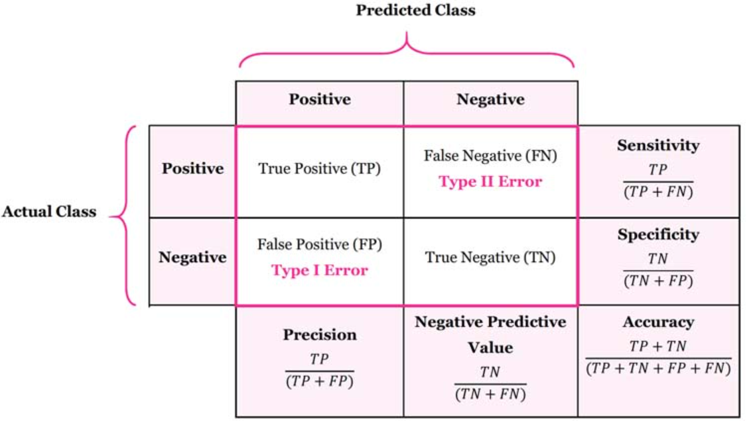

Slide 12




Model Evaluation Metrics: Confusion Matrix
True Positives
True Negatives
False Positives
False Negatives
Correctly predicted positive instances.
Correctly predicted negative instances.
Incorrectly predicted positive instances.
Incorrectly predicted negative instances.
Notes:
5

Slide 13
Accuracy, Precision, Recall, F1-Score
Accuracy
Precision
Recall
Overall correctness of the model's predictions.
Proportion of true positives among all positive predictions.
Proportion of true positives among all actual positive instances.
The F1-score is the harmonic mean of precision and recall, providing a balanced evaluation metric.
Notes:
6

Slide 14



Overfitting and Underfitting
Overfitting
Underfitting
Optimal Fit
The model performs well on the training data but fails to generalize to new, unseen data.
The model is too simple and fails to capture the underlying patterns in the data.
The model strikes a balance, performing well on both training and unseen data.
Notes:
7

Slide 15





Hands-on Classification Example
Dataset
Algorithm
Collect and preprocess a labeled dataset for the classification task.
Choose an appropriate classification algorithm and train the model.
Evaluation
Iteration
Assess the model's performance using metrics like accuracy, precision, and recall.
Refine the model by tuning hyperparameters or gathering more data.
Notes:
8

